Slide 1

Introduction to Machine Learning Day 1
Machine Learning Course
Sammie Omranian
6/10/2024

Slide 2
About instructor
Sammie Omranian
PhD student in Biomedical and Health Informatics
Research area: Applications of Natural Language Processing in Healthcare
Research Trainee at Brigham and Women’s Hospital, Harvard Medical School

Slide 3
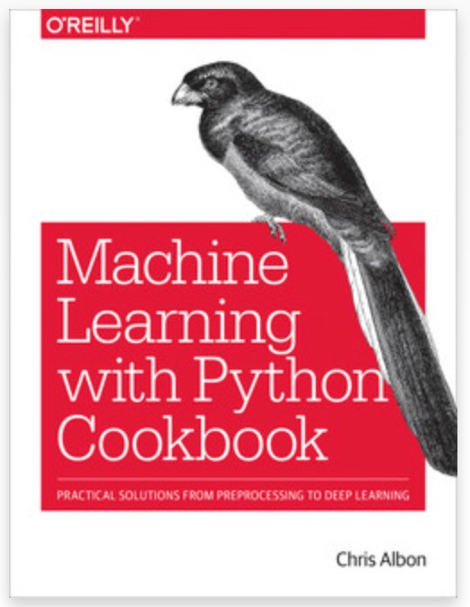
Book
Book description from O’REILY website:
This practical guide provides nearly 200 self-contained recipes to help you solve machine learning challenges you may encounter in your daily work.
Vectors, matrices, and arrays
Handling numerical and categorical data, text, images, and dates and times
Dimensionality reduction using feature extraction or feature selection
Model evaluation and selection
Linear and logical regression, trees and forests, and k-nearest neighbors
Support vector machines (SVM), naïve Bayes, clustering, and neural networks
Saving and loading trained models

Slide 4
Terminology Used in This Book
Observation
A single unit in our level of observation—for example, a person, a sale, or a record.
Learning algorithms
An algorithm used to learn the best parameters of a model—for example, linear regression, naive Bayes, or decision trees.
Models
An output of a learning algorithm’s training. Learning algorithms train models, which we then use to make predictions.
Parameters
The weights or coefficients of a model learned through training.
Hyperparameters
The settings of a learning algorithm that need to be set before training.

Slide 5
Terminology Used in This Book
Performance
A metric used to evaluate a model.
Loss
A metric to maximize or minimize through training.
Train
Applying a learning algorithm to data using numerical approaches like gradient descent.
Fit
Applying a learning algorithm to data using analytical approaches.
Data
A collection of observations.

Slide 6
Introduction to Machine Learning
Arthur Samuel (1959), an American pioneer in the field of artificial intelligence, defined machine learning as:
The field of study that gives computers the ability to learn without being explicitly programmed.
He developed the checkers-playing program, in the late 1950s, one of his most notable achievements in the field of artificial intelligence and machine learning.

Slide 7
Introduction to Machine Learning
Tom Mitchell, a renowned computer scientist, defined machine learning as:
"A computer program is said to learn from experience E with respect to some task T and some performance measure P if its performance on T, as measured by P, improves with experience E."

Slide 8
Machine Learning Algorithms
Learning Algorithms
Supervised Learning
Unsupervised Learning
Reinforcement Learning

Slide 9
Introduction to Machine Learning
Types of ML:
- Supervised Learning: Learning from labeled data (e.g., classifying emails as spam or not spam).
- Unsupervised Learning: Finding patterns in unlabeled data (e.g., clustering customers based on purchasing behavior).
- Reinforcement Learning: Learning by interacting with an environment to maximize cumulative reward (e.g., training a robot to walk).

Slide 10
Introduction to Machine Learning
Applications:
- Healthcare (predicting diseases)
- Finance (fraud detection)
- Marketing (customer segmentation)
- Autonomous vehicles (self-driving cars)

Slide 11
Introduction to Machine Learning
Workflow:
Data Collection
Data Preprocessing
Model Training
Model Evaluation
Model Deployment

Slide 12
Supervised Learning
Regression
Classification

Slide 13
Supervised Learning
Regression vs Classification:
- Regression: Predicting continuous values (e.g., house prices).
- Classification: Predicting categorical values (e.g., whether a tumor is benign or malignant).

Slide 14
Supervised Learning
Key Concepts:
- Features: Independent variables used as input.
- Labels: Dependent variables (target) we want to predict.
- Training Set: Subset of data used to train the model.
- Test Set: Subset of data used to evaluate the model's performance.

Slide 15
Data Preprocessing
Loading data with pandas
Handling missing values
Feature scaling and normalization
Splitting data into training and test sets

Slide 16
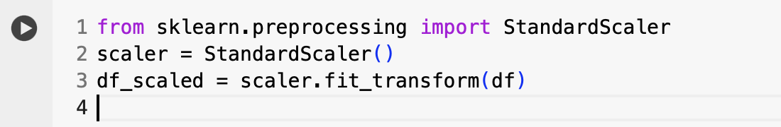
Data Preprocessing
Feature scaling and normalization
Splitting data into training and test sets

Slide 17
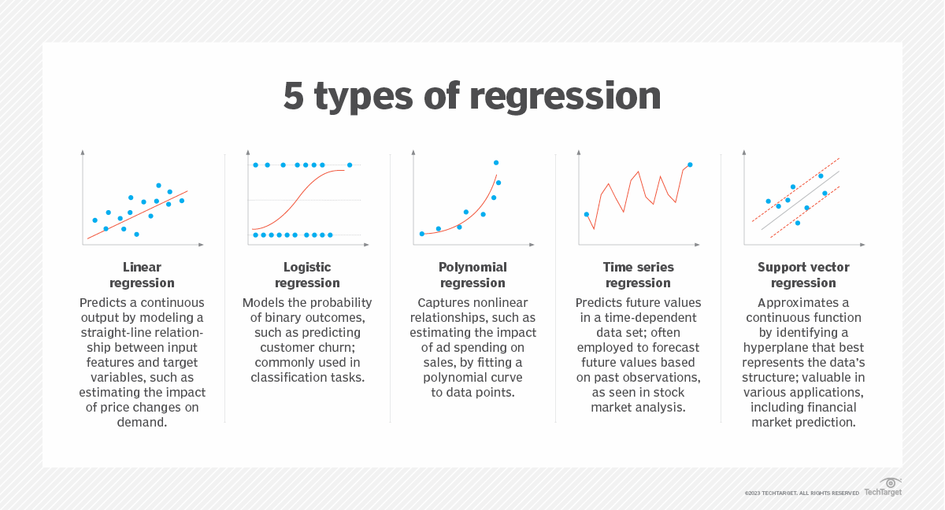
Regression
Source: techtarget
Notes:
Linear regression models assume a linear relationship between a target and predictor variables. The model aims to fit a straight line representing the data points. Linear regression is useful when there is a linear relationship between the variables, such as predicting sales based on advertising expenditure or estimating the impact of price changes on demand.
Logistic regression is used when the target variable is binary or has two classes. It models the probability of an event occurring -- for example, yes/no or success/failure -- based on predictor variables. Logistic regression is commonly used in business contexts for binary classification tasks such as customer churn prediction or transaction fraud detection.
Polynomial regression extends linear regression by incorporating polynomial concepts such as quadratic and cubic equations to format the predictor variables and capture cases where a straightforward linear relationship doesn't exist, such as estimating the impact of ad spending on sales.
Time series regression, such as autoregressive integrated moving average, or ARIMA, models, incorporate time dependencies and trends to forecast future values based on past observations. These are useful for business applications such as sales forecasting, demand prediction and stock market analysis.
Support vector regression (SVR) is a regression version of support vector machines and is particularly suitable for handling nonlinear relationships in high-dimensional spaces. SVR can be applied to tasks such as financial market prediction, customer churn forecasting or predicting customer lifetime value.

Slide 18

Linear Regression
A linear approach to modeling the relationship between a dependent variable and independent variable.
Mathematical Foundation:
$y^{′}=b+w_{1}x_{1}$
where:
$y′$ is the predicted value (a desired output).
$b$ is the bias (the y-intercept), sometimes referred to as $w_{0}$.
$w_{1}$ is the weight of feature 1. Weight is the same concept as the "slope" in the traditional equation of a line.
$x_{1}$is a feature (a known input).
Although this model uses only one feature, a more sophisticated model might rely on multiple features, each having a separate weight:
$y^{′}=b+w_{1}x_{1 }+w_{2}x_{2 }$+ $w_{3}x_{3 }$+ … + $w_{n}x_{n }$

Slide 19
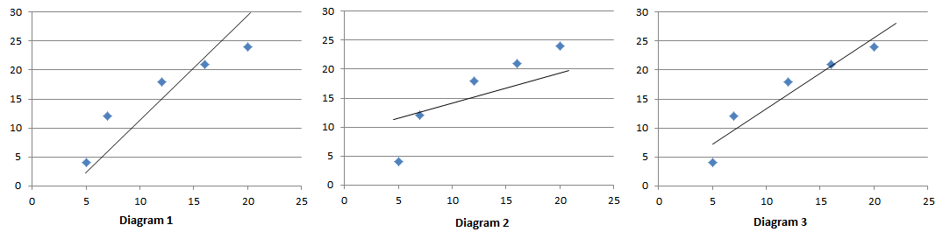
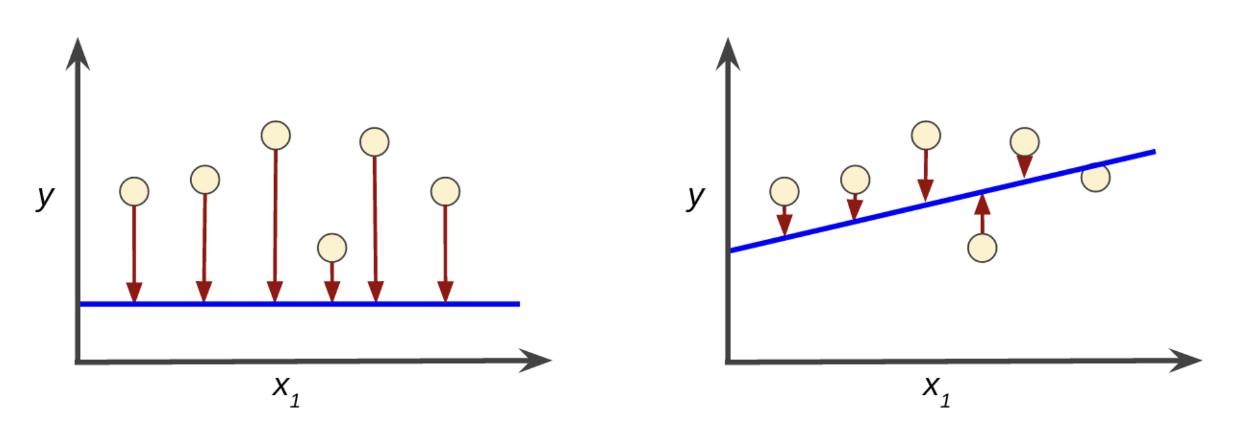

Linear Regression
$$y^{′}$$
High error (difference between actual value and predicted value) in the left model; low error in the right model.

Slide 20
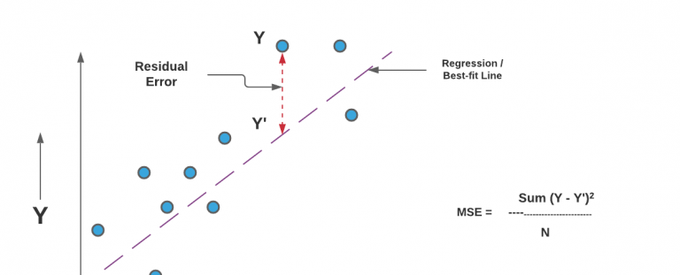
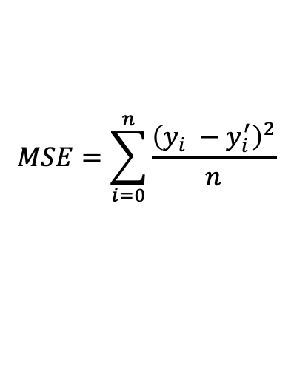
$$MSE=\sum_{i=0}^{n}{\frac{{\left(y_{i} −y_{i}^{′}\right)}^{2}}{n}}$$
X
- Cost Function: Mean Squared Error (MSE)
The cost function defined as Mean Squared Error is the sum of the squared differences between the prediction and true value. And the output is a single number representing the cost. So, the line with the minimum cost function or MSE represents the relationship between X and Y in the best possible manner.

Slide 21

Linear Regression
Gradient Descent: An iterative optimization algorithm to find values of the model parameters (bias and weights) that minimize the cost function.
$$MSE=\sum_{i=0}^{n}{\frac{{\left(y_{i} −y_{i}^{′}\right)}^{2}}{n}}$$
Now , we can use gradient descent to find optimum parameters which is an iterative algorithm and apply the following rule “ update rule” .
$$w_{i}=w_{i−1}−learning rate ∗ ∂(MSE\left(b,w_{i}\right))/∂w$$
$$b_{i}=b_{i−1} −learning rate ∗ ∂(MSE\left(b_{i},w\right))/∂b$$
Cost function
gradient

Slide 22
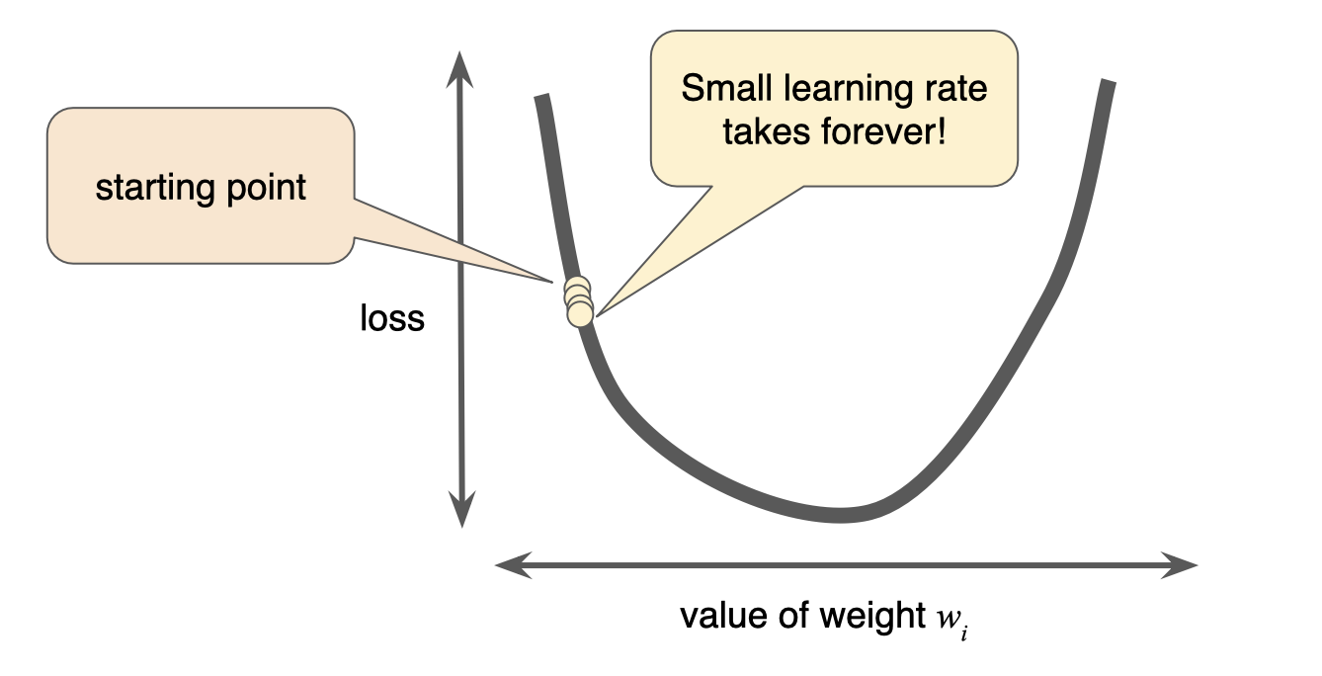
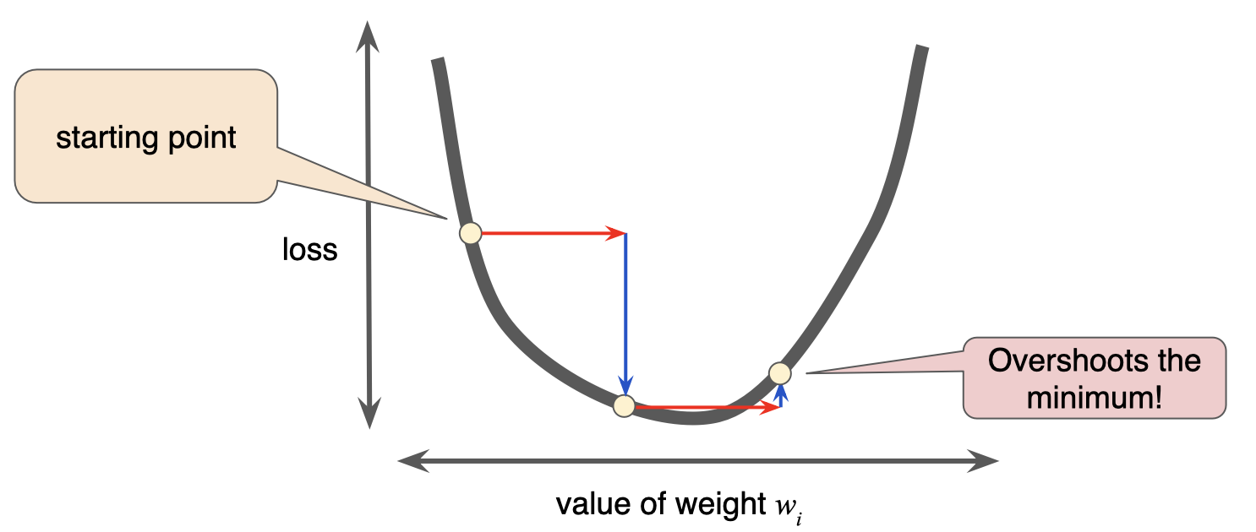
Linear Regression
Learning rate decides the size of steps in gradient descent algorithm. The programmer sets this rate. It should not be too large nor too small. if it takes large steps ,it may miss the optimum point . If it takes too small , it may take too many iterations and consume large computation time.
There's a Goldilocks learning rate for every regression problem. The Goldilocks value is related to how flat the loss function is. The common values are [0.00001,0.0001, 0,001, 0.01, 0.1, 1]. You can check if your learning rate is doing well by plotting it on a graph.

Slide 23
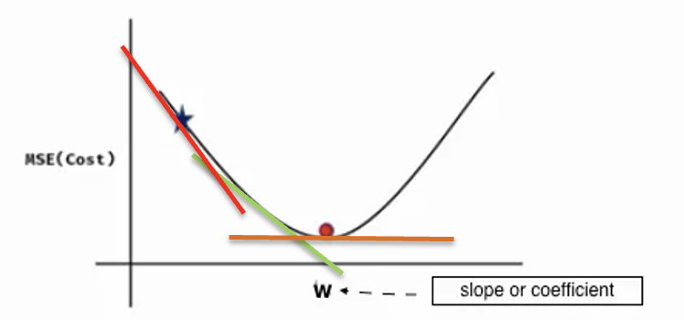
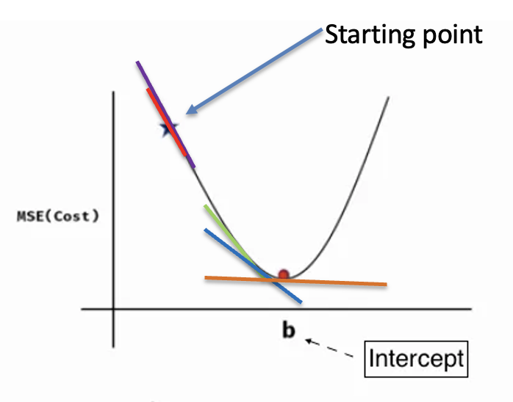

Linear Regression
$$w_{i}=w_{i−1}−learning rate ∗ ∂(MSE\left(b,w_{i}\right))/∂w$$
$$b_{i}=b_{i−1} −learning rate ∗ ∂(MSE\left(b_{i},w\right))/∂b$$
$${precision=abs(w}_{i}−w_{i−1})$$

Slide 24
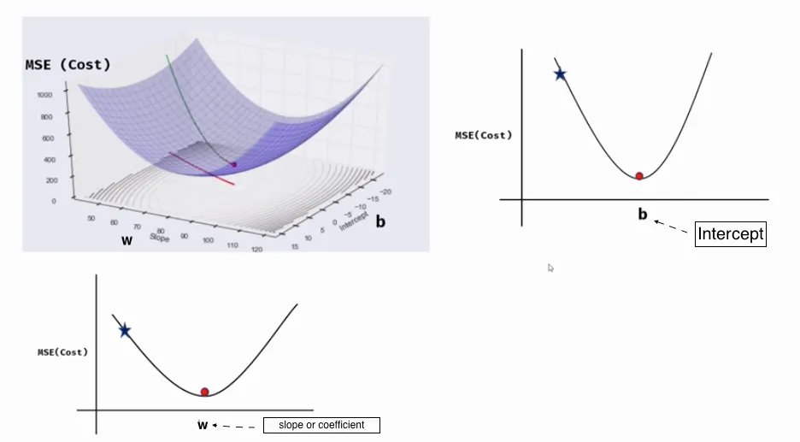

Linear Regression
Gradient vectors: $\frac{∂(MSE)}{∂w}\text{ ,} \frac{∂(MSE)}{∂b}$
3D picture of gradient descent , MSE ( cost ) with weight (w) , and MSE with bias (b).
Graph source

Slide 25
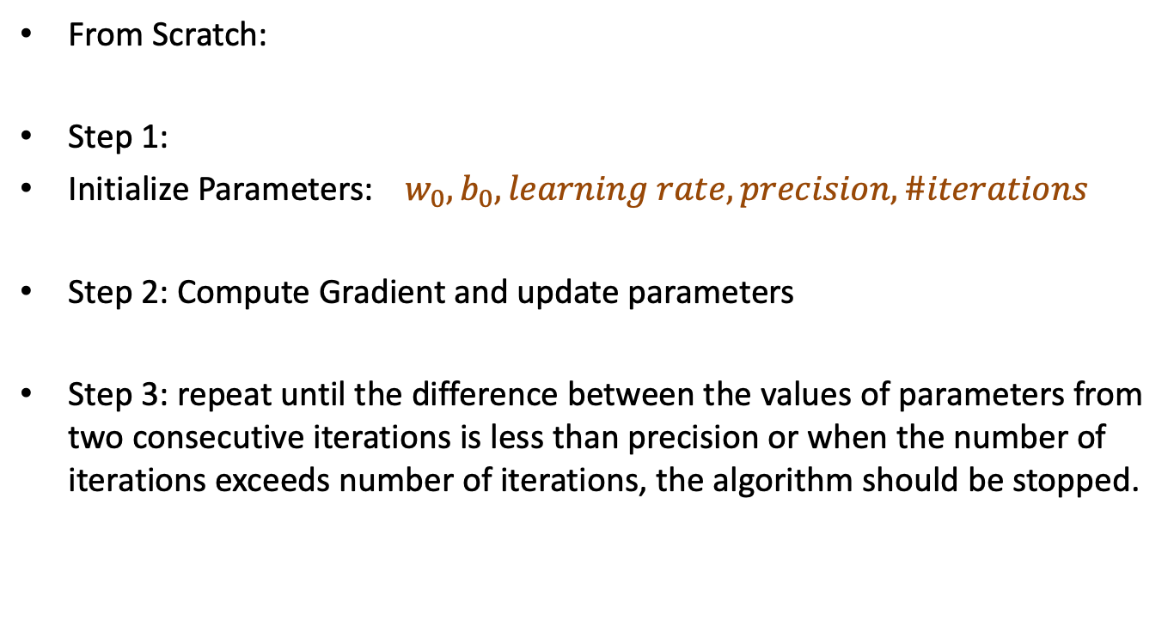
Linear Regression Implementation
From Scratch:
Step 1:
Initialize Parameters:${ w}_{0}, b_{0}, learning rate, precision, \#iterations$
Step 2: Compute Gradient and update parameters
Step 3: repeat until the difference between the values of parameters from two consecutive iterations is less than precision or when the number of iterations exceeds number of iterations, the algorithm should be stopped.

Slide 26
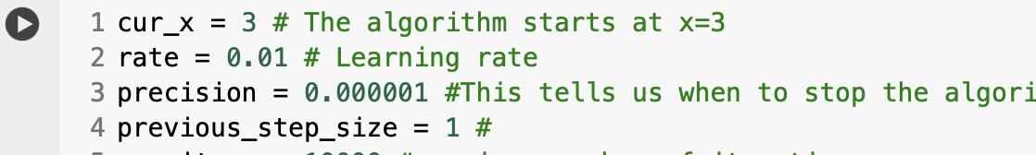
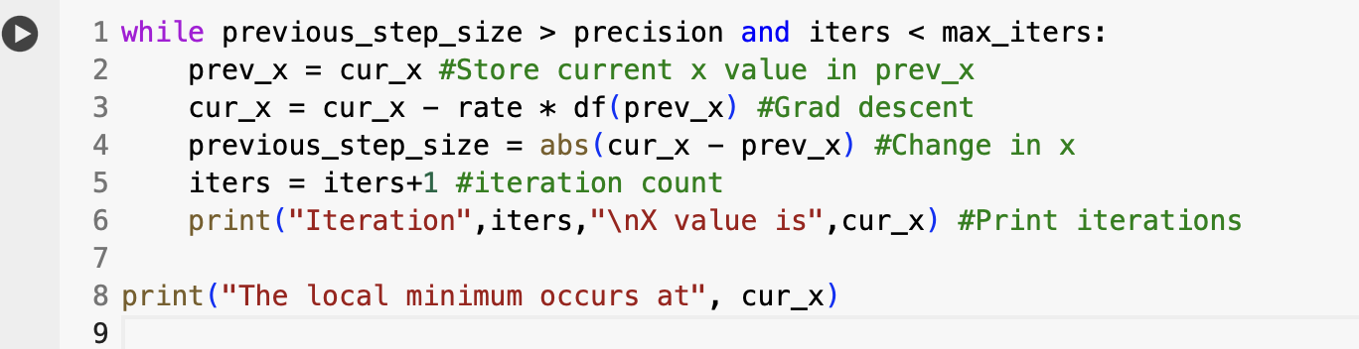
Linear Regression Implementation

